Slide 1
Introduction to Computer Science
Computer Networks

Slide 2
Objectives
In this chapter, you will learn about
Basic networking concepts
Communication protocols
Network services and benefits
A brief history of the Internet and the World Wide Web

Slide 3
Basic Networking Concepts
Computer network
Set of independent computer systems connected by telecommunication links
Purpose: Sharing information and resources
Nodes, hosts, or end systems
Individual computers on a network

Slide 4
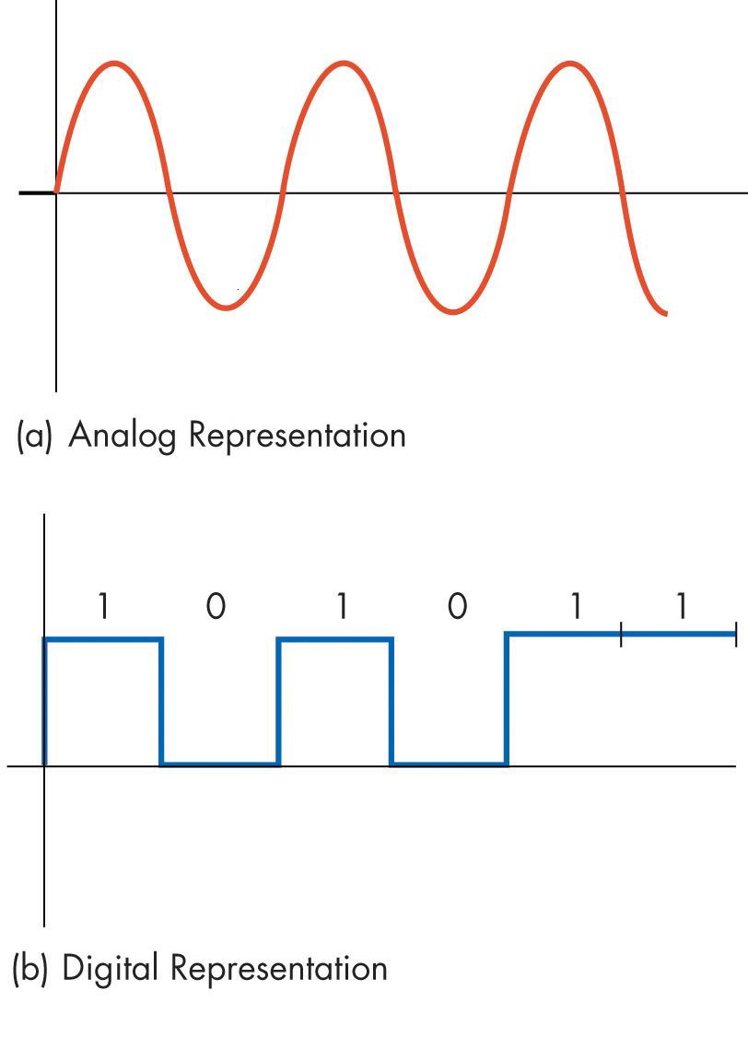
Communication Links
Switched, dial-up telephone line
A circuit is temporarily established between the caller and callee
Analog medium
Requires modem at both ends to transmit information produced by a computer
Computer produces digital information
Two Forms of Information Representation

Slide 5
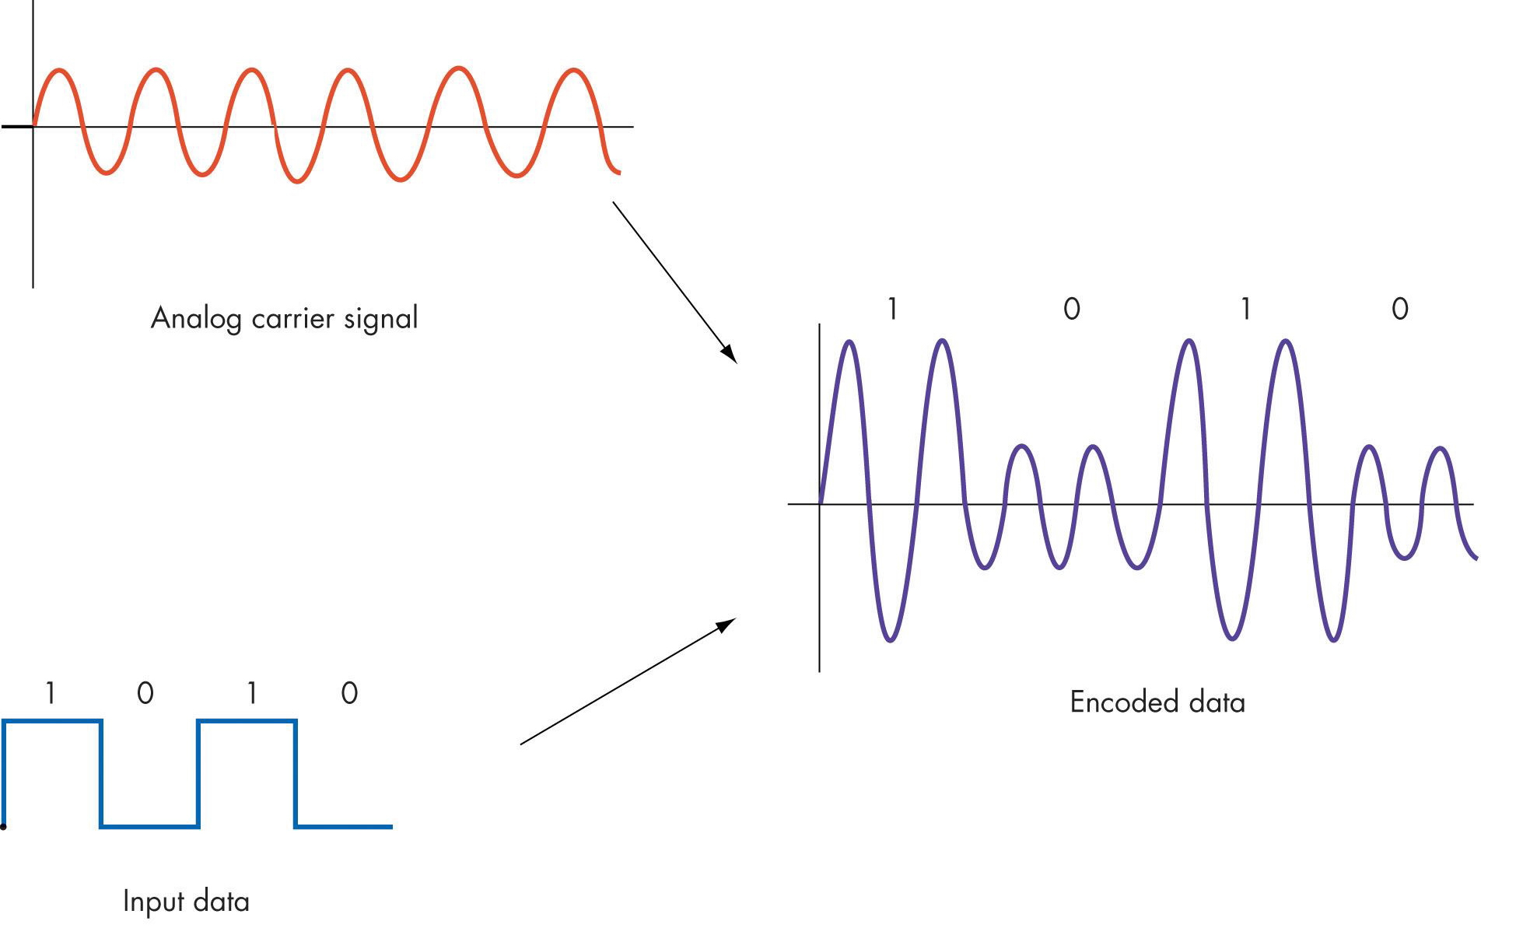
Modulation of a Carrier to Encode Binary Information

Slide 6
Communication Links (continued)
Dial-up phone links
Transmission rate: 56,000 bps (56 Kbps)
Broadband
Transmission rate: Exceeding 256,000 bps (256 Kbps)

Slide 7
Communication Links (continued)
Broadband communications
Home use
Digital subscriber line (DSL)
Cable modem
Commercial and office environment
Ethernet
Fast Ethernet
Gigabit Ethernet

Slide 8
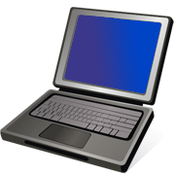
Communication Links (Home use)
Wall Jack
Wall Jack
Ethernet Cable
DSL/Cable Modem
DSL/Cable Modem
Hub/Switch/Router
USB/Ethernet Cable
Multiple machines
Single machine

Slide 9
Communication Links (Home use)
Wall Jack
Ethernet Cable
DSL/Cable Modem
Hub/Switch/Router
Home wireless network

Slide 10
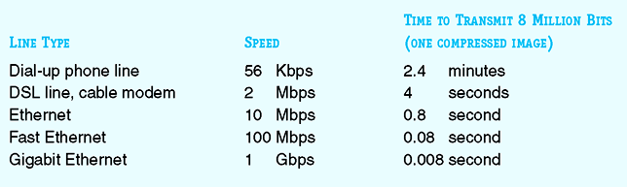
Transmission Time of an Image at Different Transmission Speeds

Slide 11
Communication Links (continued)
Wireless data communication
Uses radio, microwave, and infrared signals
Enables “mobile computing”
Types of wireless data communication
Wireless local access network
Wireless wide-area access network

Slide 12
Network Types
LAN
WLAN
WAN

Slide 13
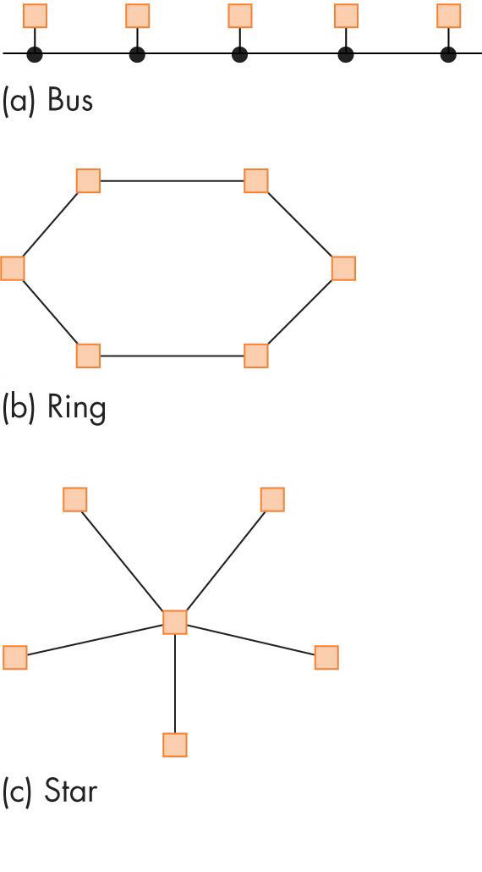
Local Area Networks
A network of computers that are in the same physical location, such as home or building
Common wired LAN topologies
Bus
Ring
Star

Slide 14
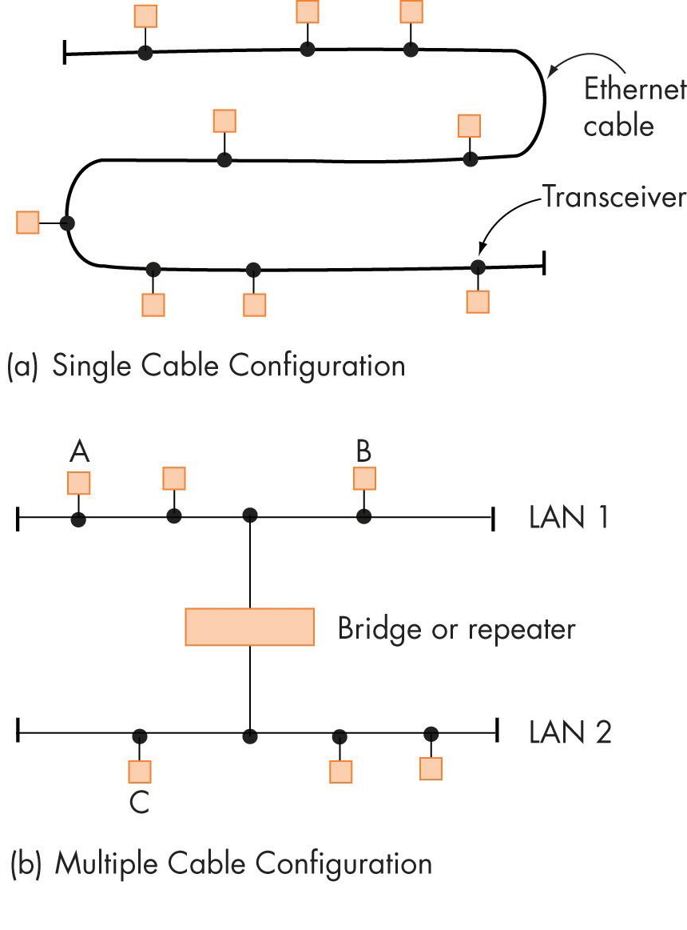
An Ethernet LAN Implemented Using Shared Cables

Slide 15
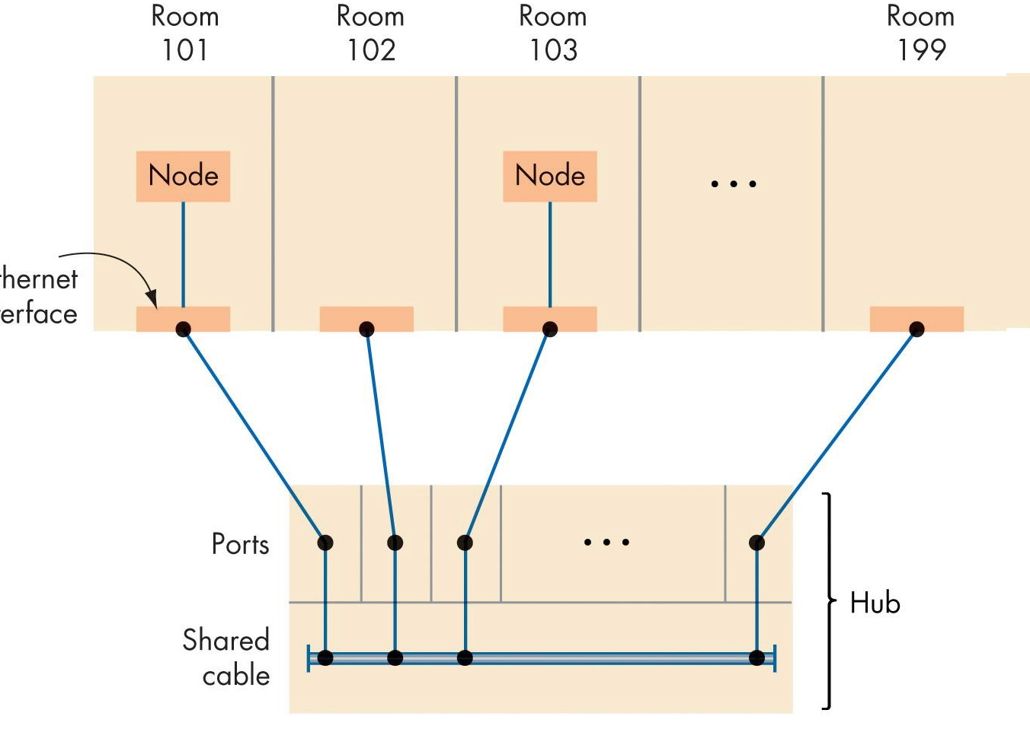
An Ethernet LAN Implemented Using a Hub

Slide 16
Local Area Networks (continued)
Ethernet
Most widely used LAN technology
Uses the bus topology
Two ways to construct an Ethernet LAN
Shared cable
Hubs: The most widely used technology

Slide 17
LAN (Local Area Network)
Ethernet Standard
10BaseT
10Mbps (Mega bits per second)
100BaseT
100Mbps
1000BaseT
1000Mbps or 1Gbps

Slide 18
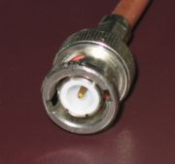
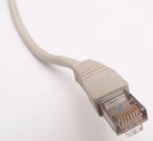
LAN (Local Area Network)
Old: BNC connector for coaxial cable
New: RJ45 for twisted pair cable
http://en.wikipedia.org/wiki/Image:BNC_connector.jpg
http://en.wikipedia.org/wiki/Image:Ethernet_RJ45_connector_p1160054.jpg

Slide 19
LAN (Local Area Network)
Question: Can 2 computers communicate by connecting each other using an Ethernet cable back-to-back?

Slide 20
WLAN (Wireless LAN)
Wi-Fi (Wireless Fidelity)
A wireless technology that connects computers without cables
Access Point (AP)
A device (base station) that connects wireless devices together
Usually connected to a wired-network
ESSID (Extended Service Set ID)
A “name” for the AP, eg. mobilenet
Hotspot
The area covered by wireless access points

Slide 21
WLAN (Wireless LAN)
Standard
802.11b - 11Mbps
802.11g - 54Mbps
802.11a - 54Mbps
Security
WEP (Wired Equivalen Privacy)
WPA (Wi-Fi Protected Access)
To prevent wardriving
2.4G
5G

Slide 22
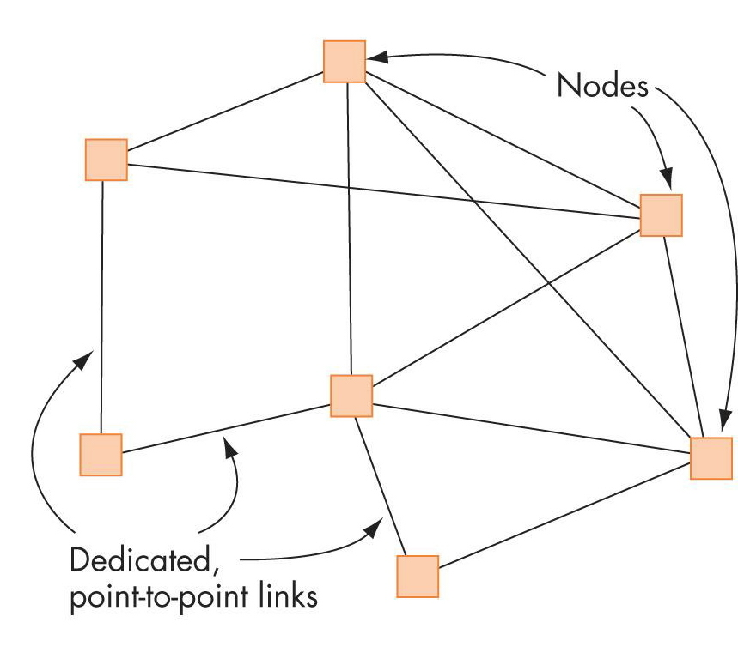
Wide Area Networks
Wide area networks (WANs)
Connect devices that are across town, across the country, or across the ocean
Users must purchase telecommunications services from an external provider
Dedicated point-to-point lines
Typical Structure of a Wide Area Network

Slide 23
Overall Structure of the Internet
All real-world networks, including the Internet, are a mix of LANs and WANs
Example: A company or a college
One or more LANs connecting its local computers
Individual LANs interconnected into a wide-area company network

Slide 24
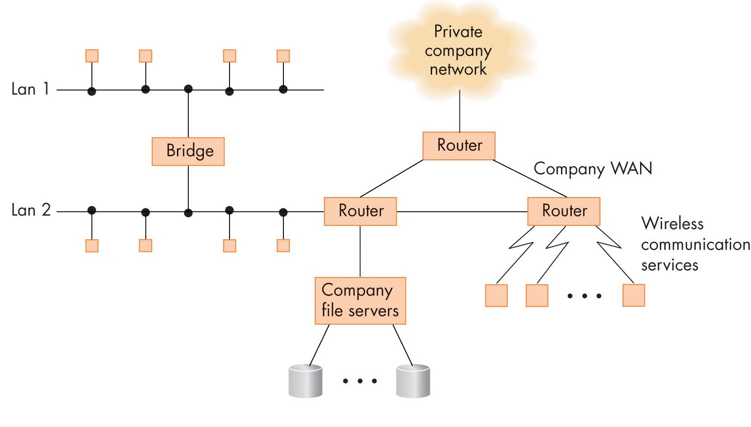
Structure of a Typical Company Network

Slide 25
Overall Structure of the Internet (continued)
Internet Service Provider (ISP)
A wide-area network
Provides a pathway from a specific network to other networks, or from an individual’s computer to other networks
ISPs are hierarchical
Interconnect to each other in multiple layers to provide greater geographical coverage

Slide 26
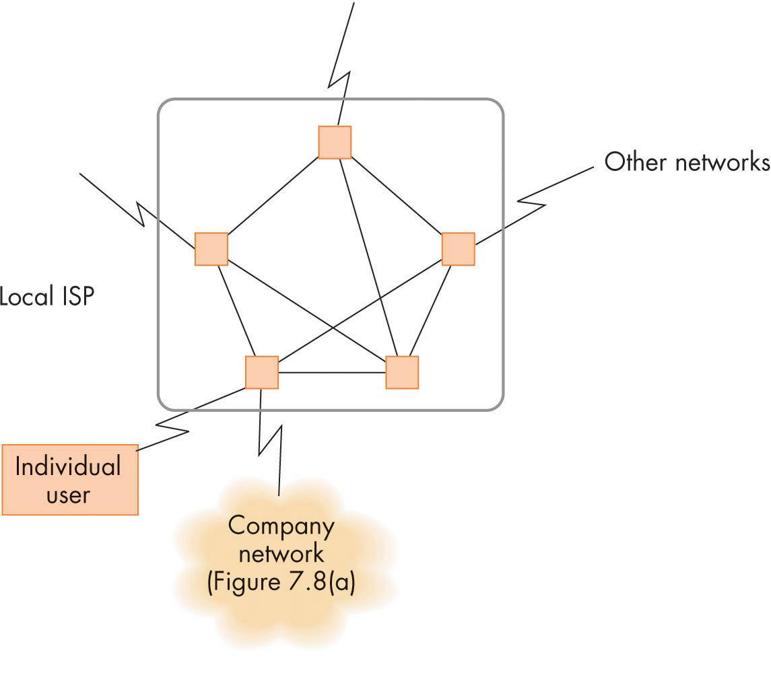
Structure of a Network Using an ISP

Slide 27
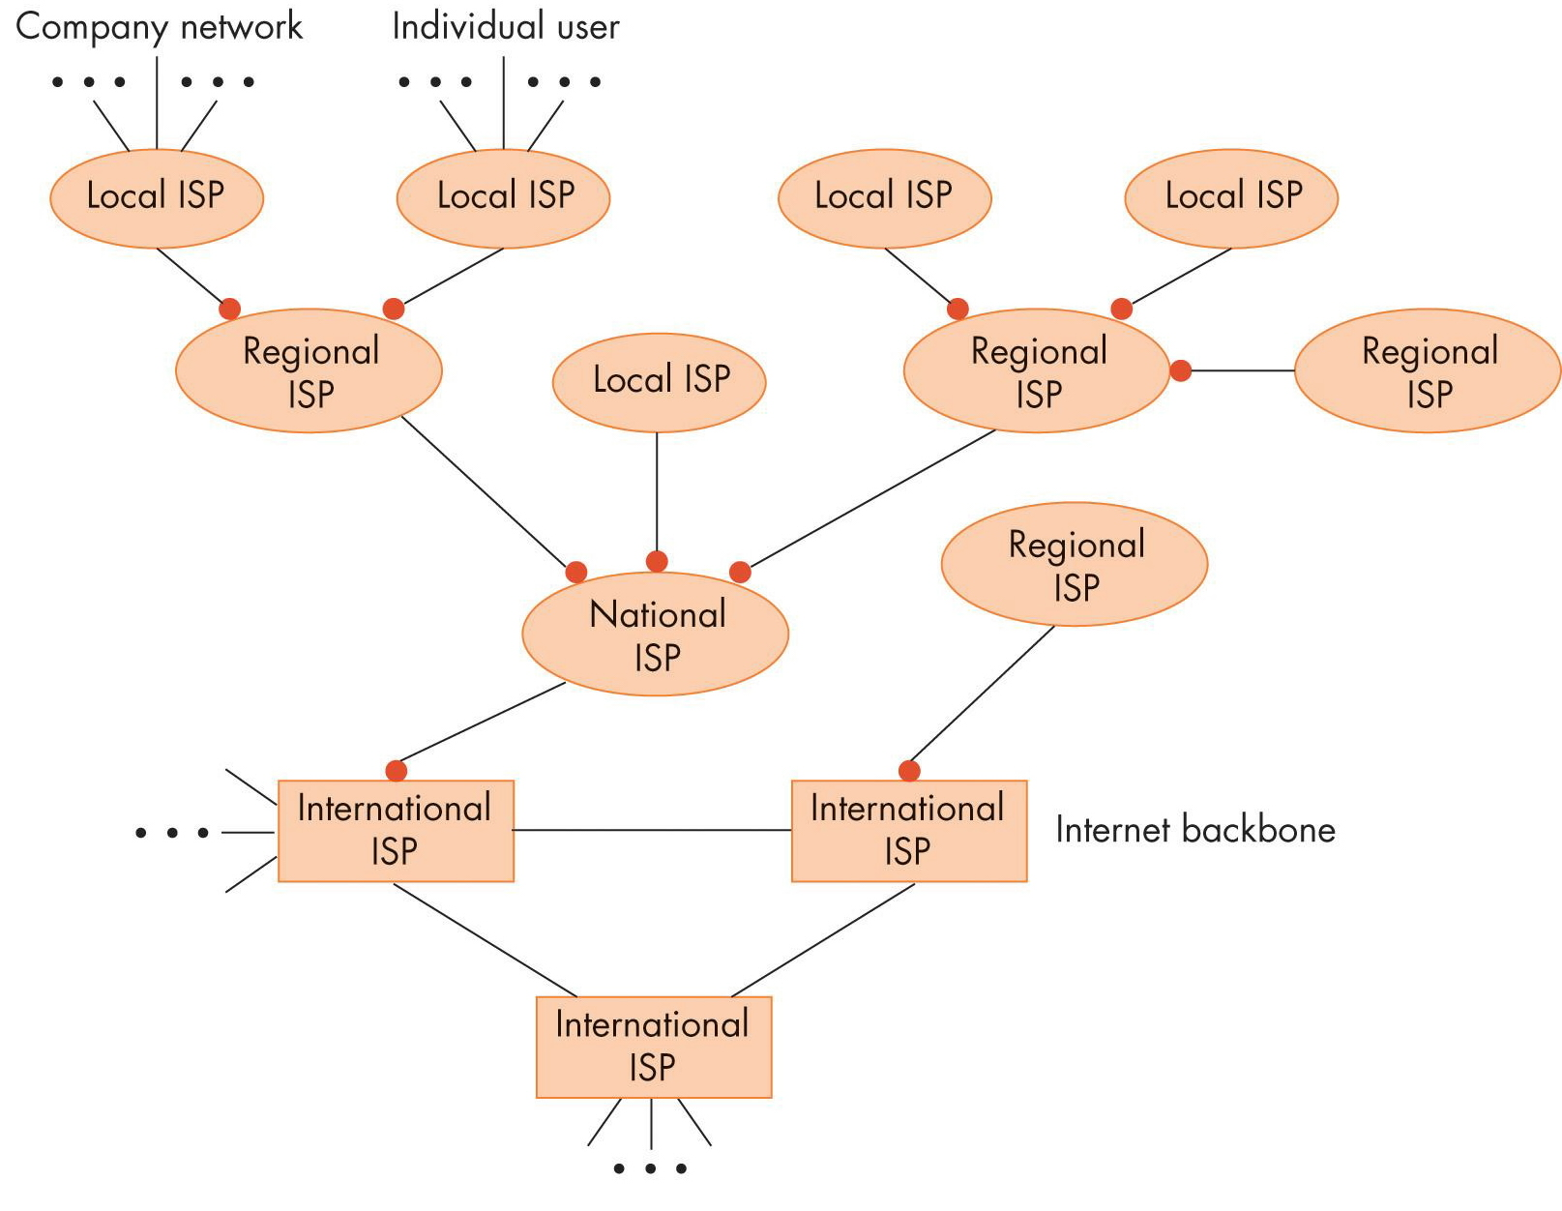
Hierarchy of Internet Service Providers

Slide 28
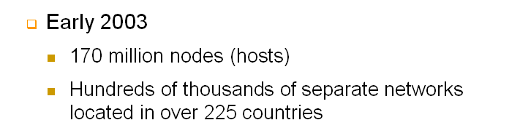
Overall Structure of the Internet (continued)
Internet
A huge interconnected “network of networks”
Includes nodes, LANs, WANs, bridges, routers, and multiple levels of ISPs
Early 2005
317 million nodes (hosts)
Hundreds of thousands of separate networks located in over 225 countries
Notes:
Click will bring up the statistics from 2003

Slide 29
Communication Protocols
A protocol
A mutually agreed upon set of rules, conventions, and agreements for the efficient and orderly exchange of information
TCP/IP
The Internet protocol hierarchy
Governs the operation of the Internet
Five layers

Slide 30
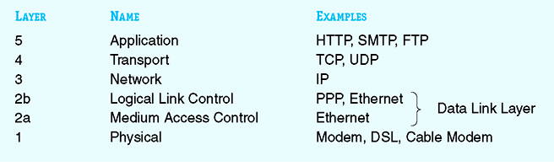
TCP/IP
Data
Segments
Packets
Frames
Bits
The Five-Layer TCP/IP Internet Protocol Hierarchy

Slide 31

Packets
A small chunk of data transmitted over the Internet
Alice
Bob
The Internet

Slide 32
Physical Layer
Protocols govern the exchange of binary digits across a physical communication channel
Goal: Create a bit pipe between two network devices Details: voltage levels, wavelengths, radio frequencies Note: different specifications for different machines and different mode of communication

Slide 33
Data Link Layer
Protocols carry out
Error handling (detection and correction)
Framing - identify the start and stop of a message
Creates an error-free message pipe
Composed of two services
Layer 2a: Medium access control
Layer 2b: Logical link control

Slide 34
Network Layer (IP protocol)
Delivers a message from the site where it was created to its ultimate destination
Critical responsibilities
Create a universal addressing scheme for all network nodes
Deliver messages between any two nodes in the network (route the packets between two nodes)

Slide 35
Network Layer (continued)
Provides a true network delivery service
Messages are delivered between any two nodes in the network, regardless of where they are located
IP (Internet Protocol) layer
Network layer in the Internet

Slide 36
Network Layer (continued)
Router
Router
Key concepts
Host names
example: gordon.edu
IP addresses
example: 200.56.34.100
Domain name system (DNS)
(def) converts a symbolic host name to 32-bit IP address
Routing
store and forward & best path

Slide 37
Transport Layer
Provides a high-quality, error-free, order- preserving, end-to-end delivery service
TCP (Transport Control Protocol)
Primary transport protocol on the Internet
Requires the source and destination programs to initially establish a connection

Slide 38
Transport Layer
Port: 23
Port: 78
Port: 80
Port: 567
Router
Router
Host A: 122.45.65.17
Host B: 100.44.44.5
Key Concepts
1. Port Numbers
(def) identifies a specific application on a host
2. Well-known port numbers
3. TCP (transport control protocol)
requires a handshake and connection setup
4. UDP (user datagram protocol)

Slide 39
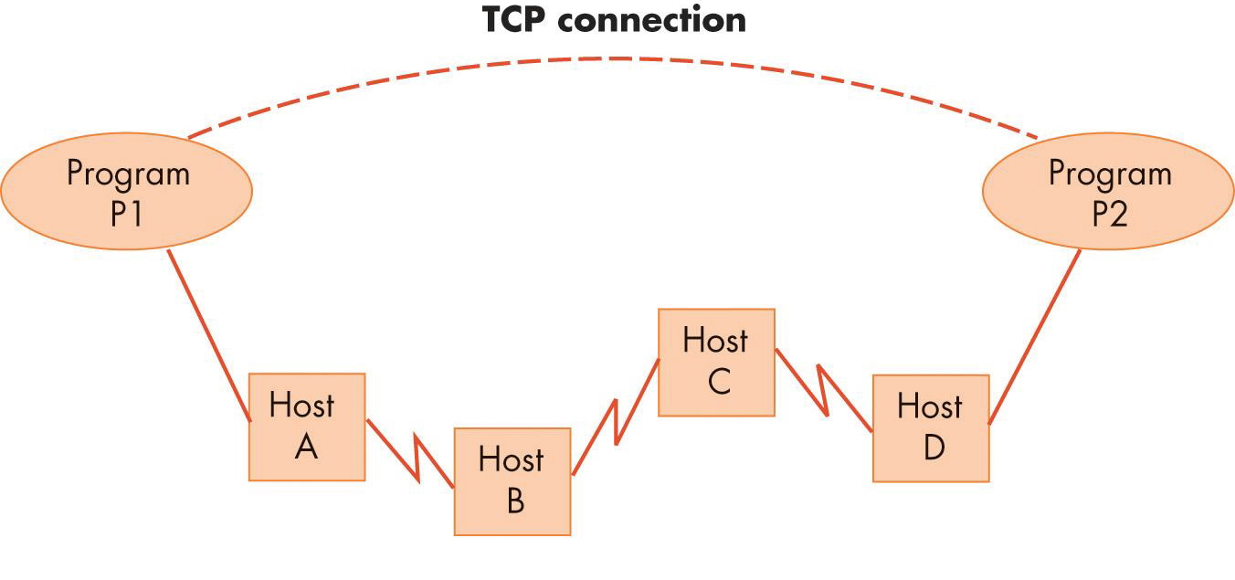
Logical View of a TCP Connection

Slide 40
Application Layer
Implements the end-user services provided by a network
There are many application protocols
HTTP (hypertext transfer protocol)
SMTP (simple mail transfer protocol)
POP3
IMAP
FTP (file transfer protocol)

Slide 41
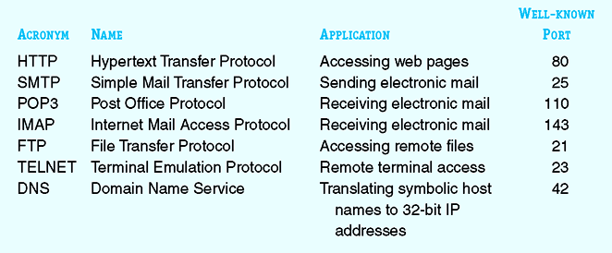
Some Popular Application Protocols on the Internet

Slide 42
Application Layer (continued)
Uniform Resource Locator (URL)
A symbolic string that identifies a Web page
Form
protocol://host address/page
The most common Web page format is hypertext information
Accessed using the HTTP protocol

Slide 43
Network Services and Benefits
Services offered by computer networks
Electronic mail (email)
Bulletin boards
News groups
Chat rooms
Resource sharing
Physical resources
Logical resources

Slide 44
Network Services and Benefits (continued)
Services offered by computer networks
Client-server computing
Information sharing
Information utility
Electronic commerce (e-commerce)

Slide 45
A Brief History of the Internet and the World Wide Web: The Internet
August 1962: First proposal for building a computer network
Made by J. C. R. Licklider of MIT
ARPANET
Built by the Advanced Research Projects Agency (ARPA) in the 1960s
Grew quickly during the early 1970s

Slide 46
The Internet (continued)
NSFNet: A national network built by the National Science Foundation (NSF)
October 24, 1995: Formal acceptance of the term Internet
Internet service providers start offering Internet access once provided by the ARPANET and NSFNet

Slide 47
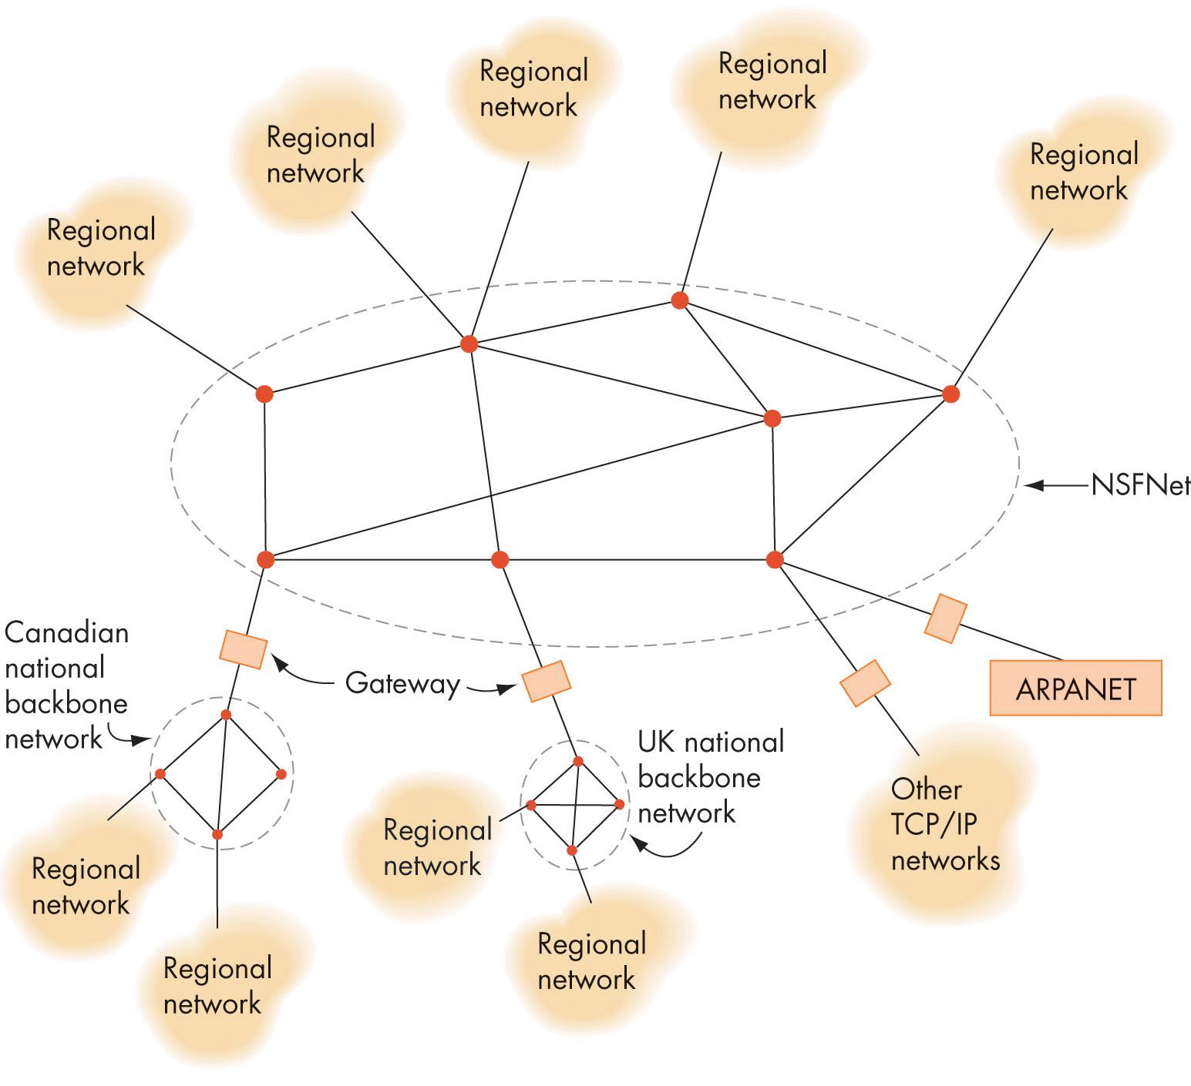
State of Networking in the Late 1980s

Slide 48
The World Wide Web
Development completed in May 1991
Designed and built by Tim Berners-Lee
Components
Hypertext
A collection of documents interconnected by pointers called links
URL (Uniform Resource Locator)
The worldwide identification of a Web page located on a specific host computer

Slide 49
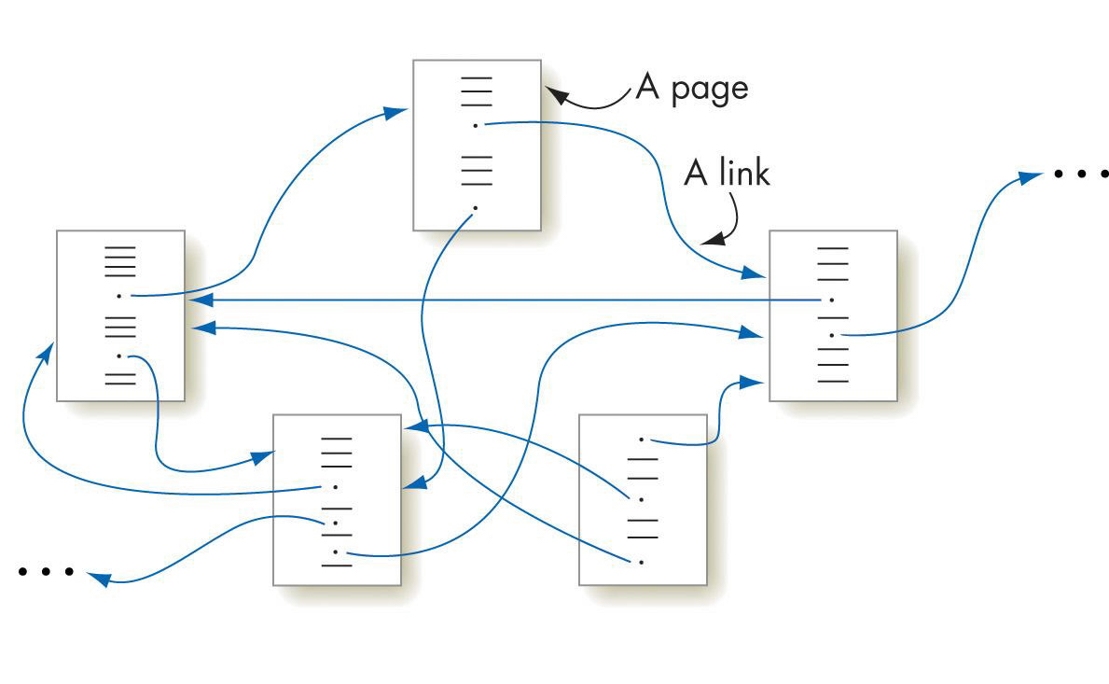
Hypertext Documents

Slide 50
Summary
Computer network: A set of independent computer systems connected by telecommunication links
Options for transmitting data on a network: Dial-up telephone lines, DSL, cable modem, Ethernet, Fast Ethernet
Types of networks: Local area network (LAN) and wide area network (WAN)

Slide 51
Summary (continued)
The Internet is a huge interconnected "network of networks"
TCP/IP is the Internet protocol hierarchy, composed of five layers: physical, data link, network, transport, and application
The World Wide Web is an information system based on the concept of hypertext

